Slide 1
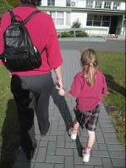
Control over the social world
If we all use the same strategies to interact with the student with low vision!
That student can develop a greater sense of anticipation and predictability. Taking away the guess work and giving a sense of control

Slide 2
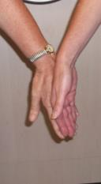
Guiding and supporting interaction
Approach: Say your name and offer to assist, taking TIME for the student to respond!
Contact: Offering the hand is a socially acceptable and known method. He then knows where you are, and he can take your arm, without ‘groping’

Slide 3
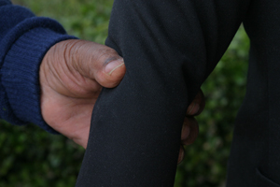
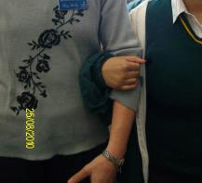
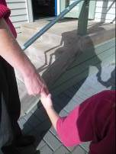
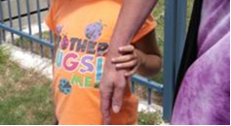
The yoke Grip or other adapted grips may be useful
This adapted grip may be useful if the student needs more support
Yoke grip
Shorter people may need to hold lower than the elbow

Slide 4
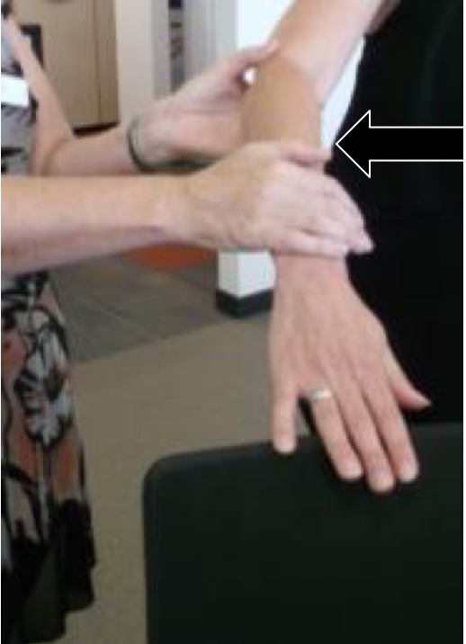
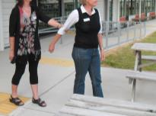
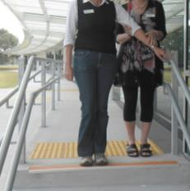
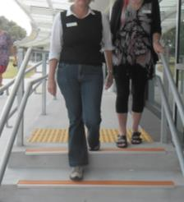
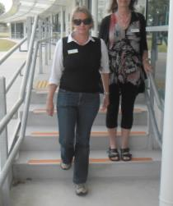
Other Guiding techniques
Narrow spaces
Guides Arm
contacting objects
steps

Slide 5
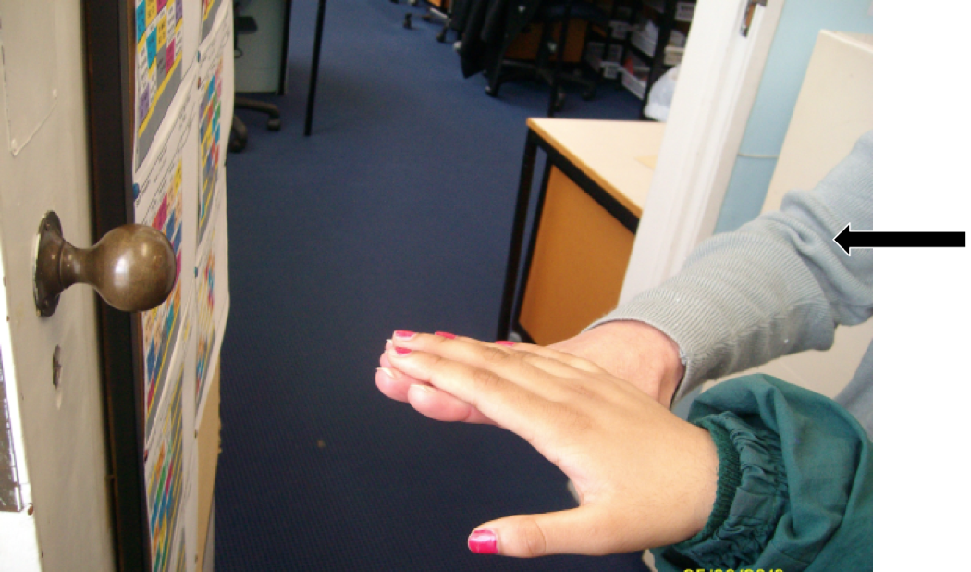
Encouraging connection with the world
Use hand under hand if needed or
Guides Arm

Slide 6
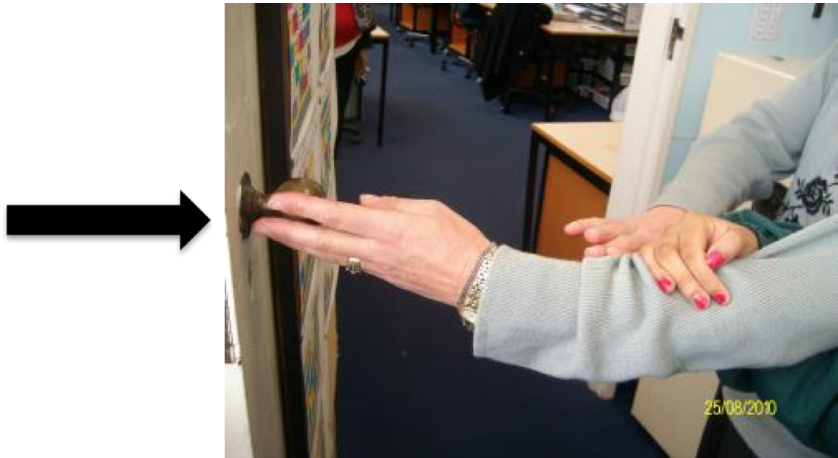
Better still if needed
Encourage trailing down your arm or the cane
Or if needed use the Three Stage Prompt:
Verbal – wait
Verbal with tapping or other concrete clue
Hand under hand
Guides Arm

Slide 7
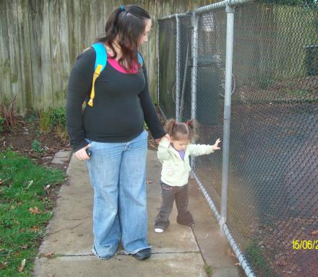
Guiding strategies
Even better use guiding to support engagement with the world and learn strategies such as Trailing!

Slide 8
Guiding
Guiding can be like being in a learning bubble
    In the learning bubble we are just moving in space and not connecting with the world
    What do we learn?
Check with your local Resource Teacher: Vision for more information
Developed by Moving Forward Ltd and BLENNZ, 2014

