Slide 1
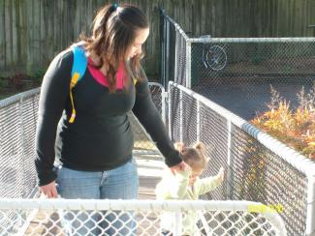
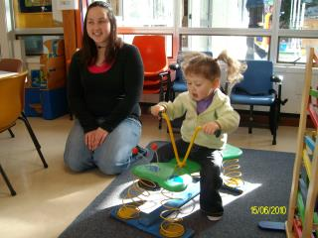
Introducing the cane
The cane can be part of an overall O&M programme

Slide 2
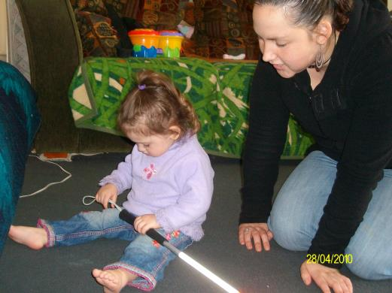
When to introduce a cane is a family and team decision
We believe early is best but it must be positive for the child and family

Slide 3
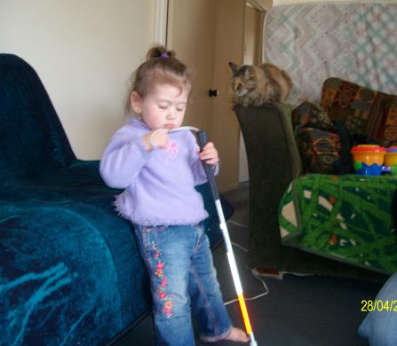
Take Time and keep it low key!
Explore it and play with it

Slide 4
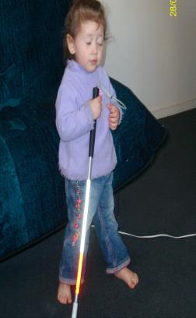
Play games and don’t worry if it isn’t used properly
It’s about making the cane a normal part of the day and routine
Bonk things with it
Tap a drum
Put it in the buggy

Slide 5
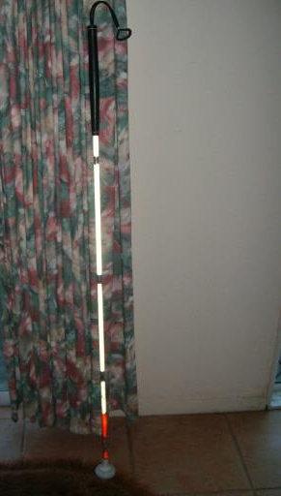
Have a place to hang it so the child can help get it as part of the routine

Slide 6
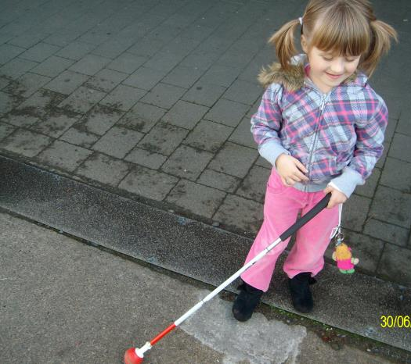
Personalise your cane
You can hang a toy on it
Give it a name
Decorating it with stickers is always fun too!

Slide 7
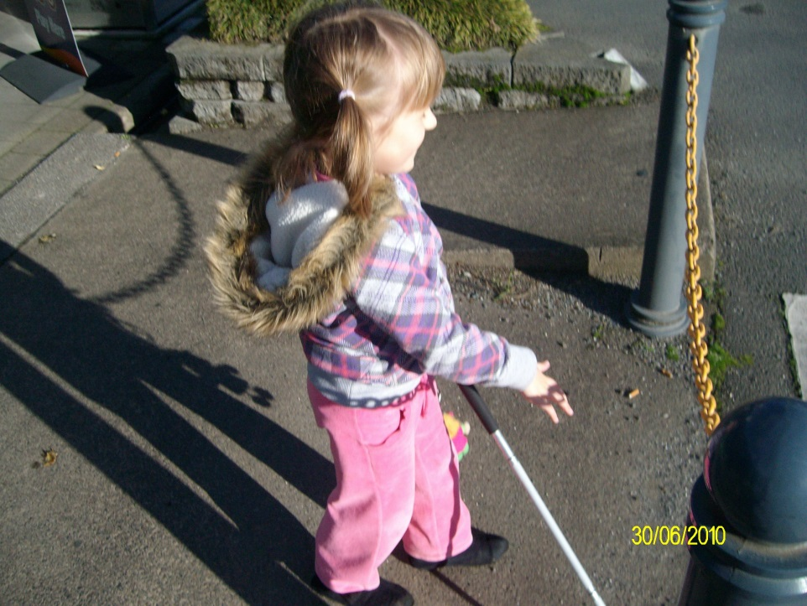
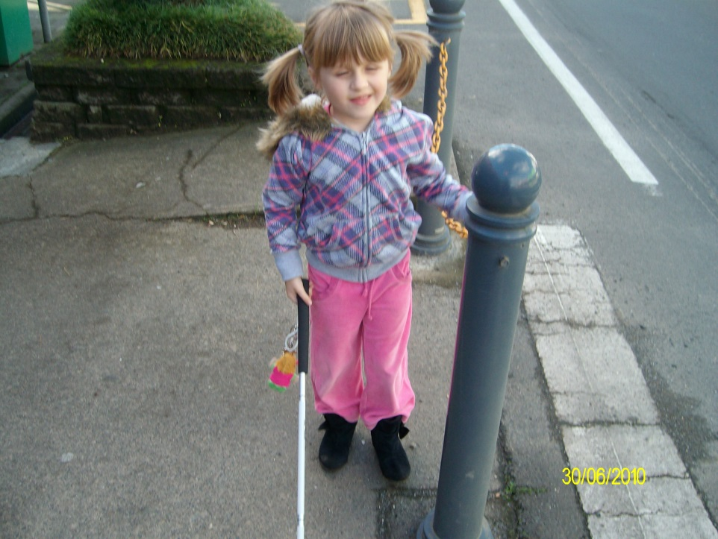
Use other techniques with the cane to explore the exciting world!
Self protection
Trailing

Slide 8
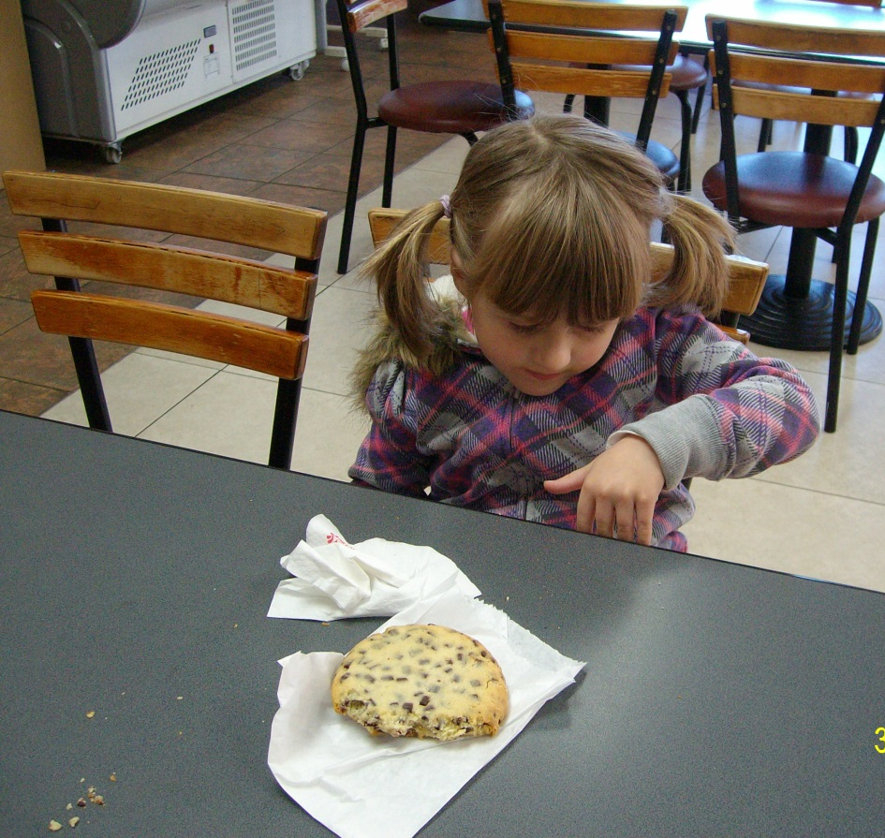
Have a motivating reason for using it!
Check with your local Resource Teacher Vision for more information
Developed by Moving Forward Ltd and BLENNZ, 2014

