Slide 1
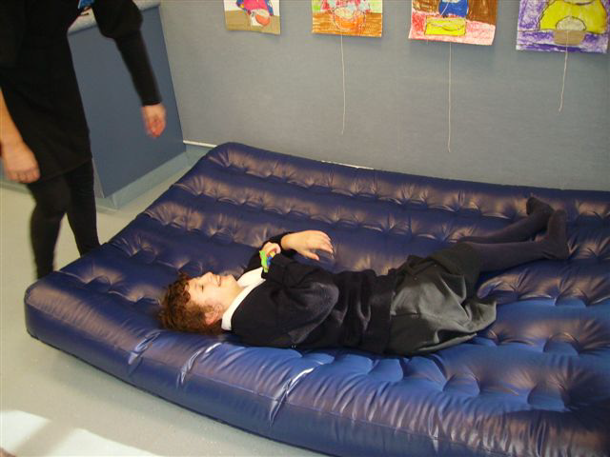
Having Fun with Sam
On the Airbed!
A tool for safe, fun movement experience and sensory-motor activities
NB: Always check with medical and therapy team members when implementing a motor play programme.

Slide 2
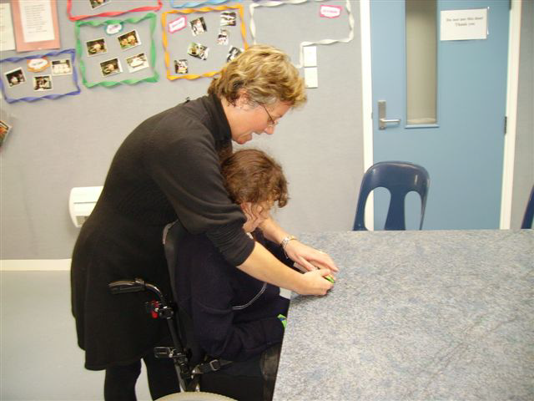
What’s coming next:
Personal Identifiers/Object Cues/signs or
other forms of communication are
important!
As always, Sam is
‘forewarned’ about what is coming up on her timetable, just before she goes to the airbed session.
She is encouraged to feel her ‘object cue’ that feels like the airbed surface. This gives her a sense of ANTICIPATION or KNOWLEDGE of what’s about to happen and provides her with CONTROL over her immediate world, both of which contribute to self esteem!
It is important that blind students, particularly those in wheelchairs, be given the opportunity to understand what is about to happen to them, otherwise its just like being in chaos all the time, not knowing where you are going or what you are expected to do!

Slide 3
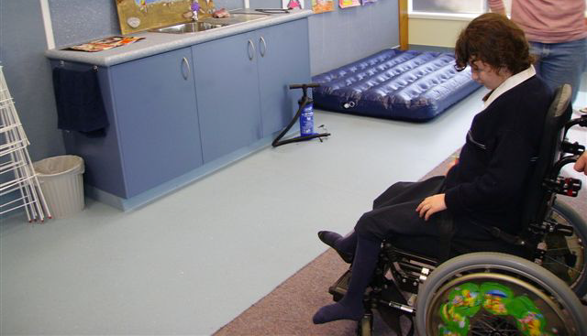
Keep the same routes
Sam is then wheeled through the SAME route to get to the airbed that is positioned by the windows all the time she uses it.
It is again really important for the team to agree on a consistent route between destinations, this gives the student who is blind and in a wheelchair a sense of ANTIPATION and CONTROL as she learns that to get to the airbed she does a 180 degree turn, pauses, is moved forward till she contacts the wall in front.

Slide 4
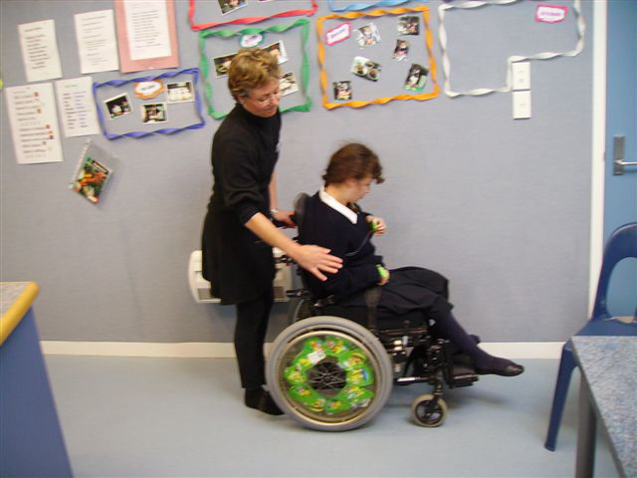
Using object cues
Have someone firmly rub her right shoulder saying “Turning right” followed by a CLEAR and PRECISE ¼ turn to the right, pause then travel along the cupboards to stop at the airbed
Here the object cue can be given again to reinforce that she is at the “airbed” and confirm that she DOES want to play!

Slide 5
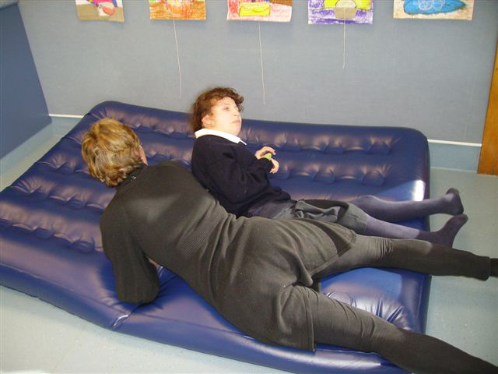
Motor activities are useful for many areas of development:
(see motor play power point)
On the airbed Sam is asked using hand signs and talking
“Do you want to bounce?” (placing your hand under Sam’s and gently moving it up and down in a bouncing movement)
Sam loves to bounce!
If she agrees that this
is what she wants to do,
the two of you can
bounce together on the airbed.

Slide 6
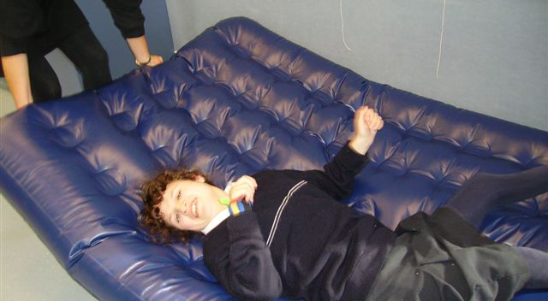
Or, she might like to bounce on her own. You can work on body/movement/turns/spatial relationships and so on.
Body movements

Slide 7
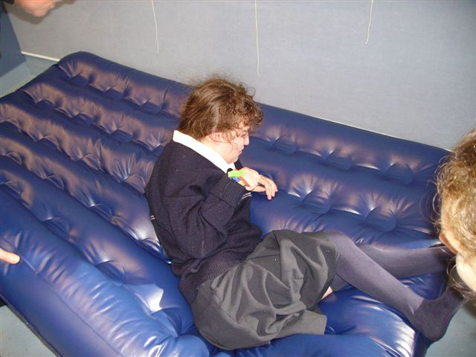
Or move about on her own and experience many positions and learn about her body through the movement.
Learning through movement

Slide 8
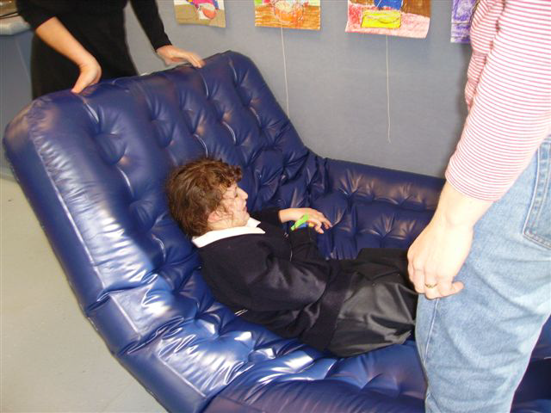
Sam also likes to explore different positions that she doesn’t get to experience in her chair, such as slowly moving her to sitting. Without! Having to push or pull her, just encourage her involvement using the airbed!
Trying new things

Slide 9
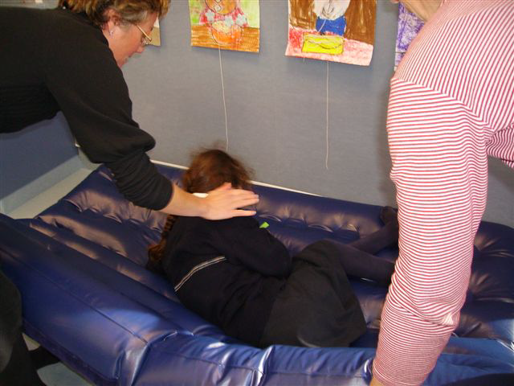
She may like to roll, one way or the other. Ask her if she wants to do rolling by using the hand sign of hands ‘rolling together’. If she does want to roll, help her anticipate which way using the firm rub to her shoulder technique.
Using hand signals to communicate

Slide 10
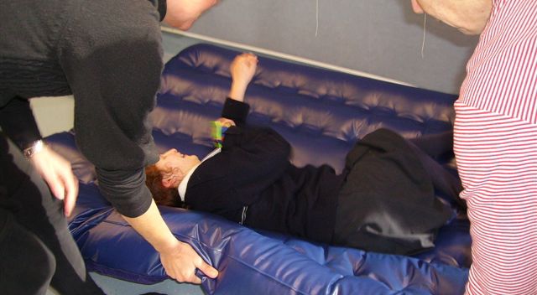
And then count three, lifting the airbed edge more until she rolls, or has fun resisting!!
Having fun

Slide 11
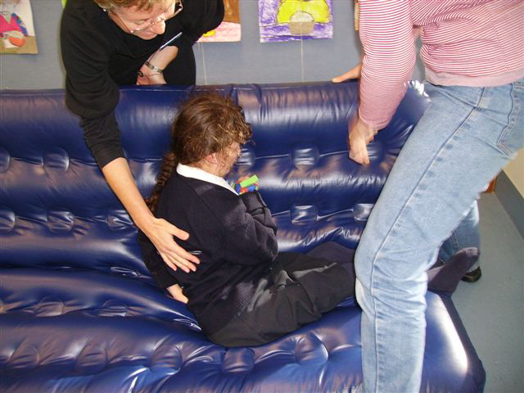
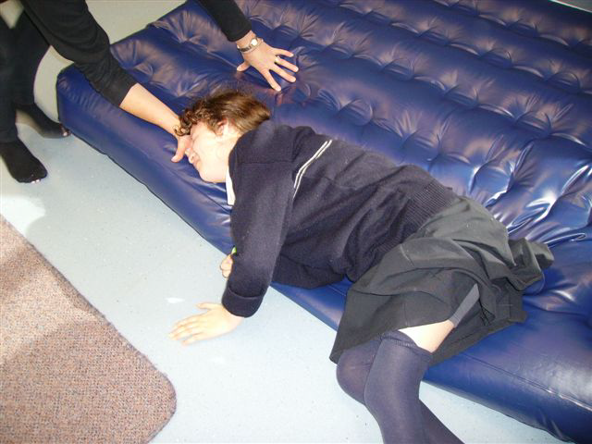
There are many movements and positions that can be explored on the airbed.
Being safe and having fun
As long as it is fun and safe!

Slide 12
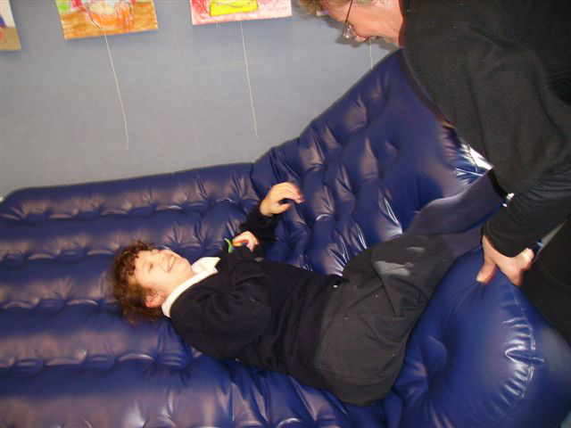
As well as using it for bouncing and rolling and learning about movement and the body that way
Sam also enjoys us using firm holding to help her brain learn about and control her lower limbs
Again using the airbed to encourage her to position so she can ‘shove’ me away with her legs and feet

Slide 13
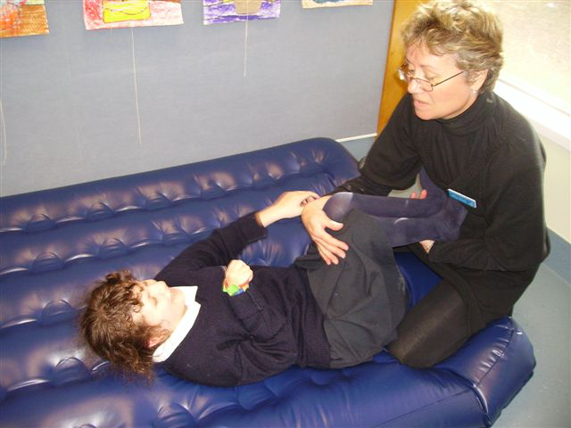
Adding firm but gentle pressure to her legs, held in the right position, gently assisting her to bend them
Can help her develop awareness and strength and control

Slide 14
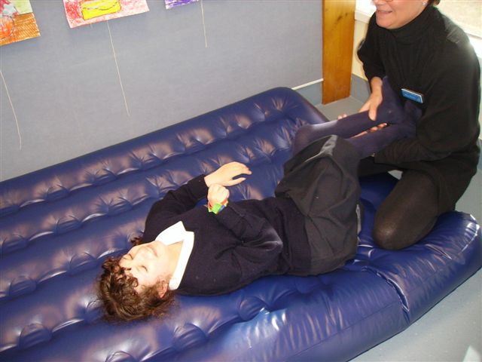
To push me away and have fun!
Check with your local Resource Teacher Vision for more information
Developed by Moving Forward Ltd and BLENNZ, 2014.

